Slide 1
Capstone Engagement
Assessment, Analysis, and Hardening of a Vulnerable System

Slide 2
Table of Contents
This document contains the following sections:
01
Network Topology
02
Red Team: Security Assessment
03
Blue Team: Log Analysis and Attack Characterization
Hardening: Proposed Alarms and Mitigation Strategies
04

Slide 3
Network Topology
3

Slide 4
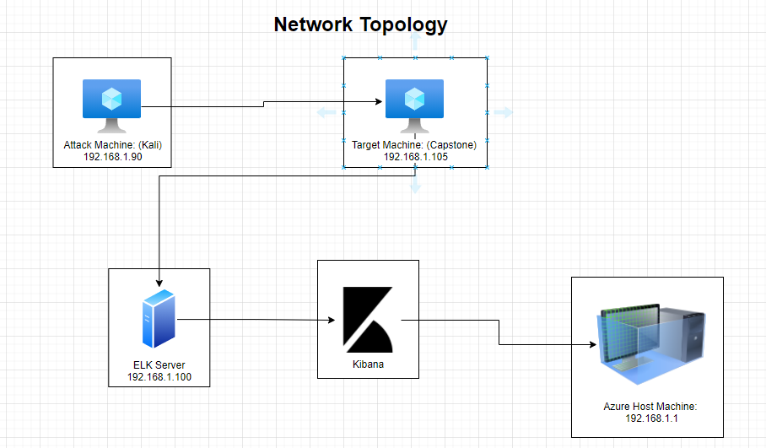
Network Topology
[Insert Here]
Use draw.io to create a diagram of the network.
Add your diagram to this slide and fill out the data in the sidebar.
Network
Address Range: 192.168.1.0/24
Netmask: 255.255.255.0
Gateway: 10.0.0.76
Machines
IPv4:192.168.1.1
OS: Windows 10
Hostname: Azure Hyper-V ML-RefVm-684427
IPv4: 192.168.1.90
OS: Linux
Hostname: Kali
IPv4: 192.168.1.100
OS: Linux
Hostname: ELK
IPv4: 192.168.1.105
OS: Linux
Hostname: Capstone

Slide 5

Red Team
Security Assessment
5

Slide 6
Recon: Describing the Target
Nmap identified the following hosts on the network:
Hostname | IP Address | Role on Network
Capstone | 192.168.1.105 | Target Machine
ELK | 192.168.1.100 | Security Monitoring
Kali | 192.168.1.90 | Attack Machine
ML-REFVM-684427 | 192.168.1.1 | Azure Host/Cloud Based Host

Slide 7
Vulnerability Assessment
The assessment uncovered the following critical vulnerabilities in the target:
Vulnerability | Description | Impact
Firewall Rules: Open Ports | Port 22 and 80 were found, via an Nmap scan, to be open. Several other ports were open including ports 2222 and 4444 | Open Ports are a potential security problem because it increases the attack surface of machine/network
Weak Password Policy (CVE-2019-3746) | Passwords were short, simple, and changed infrequently. Password hashes were not salted. | Hydra was used to brute force access to accounts. Password hashes were able to be decrypted.
Weak Authentication Controls | Only usernames and passwords were required to access accounts. There was no multi-factor authentication. | Used the passwd.dav file and msfvenom to brute force an account and access the web server.
Sensitive Data Exposure

Slide 8
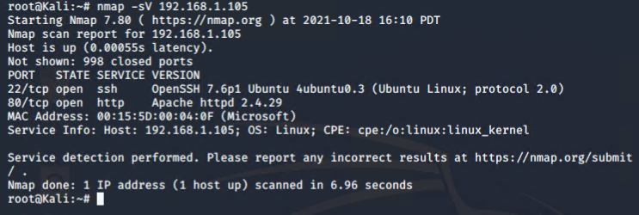
Exploitation: Firewall Rules: Open Ports
01
Tools & Processes
Nmap was used to scan for open ports on the target machine. Netdiscovery could also be used.
03
02
Achievements
This showed the available/open ports to be exploited. Ports 80 and 22 being open were of interest.

Slide 9
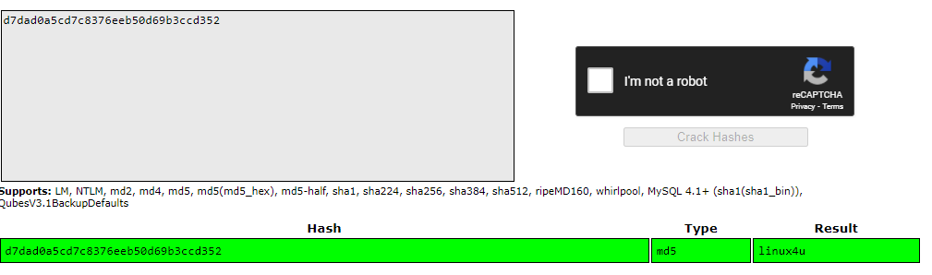
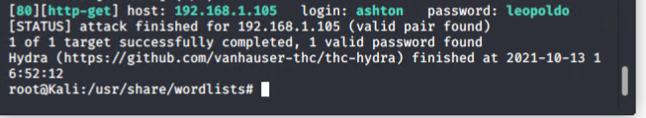
Exploitation: Weak Password Policy
Tools & Processes
The command-line tool Hydra was used to bruteforce a user's account on the specified machine. The password hashes were able to be uploaded to a password cracking website (CrackStation) with a built-in wordlist. Alternatively,
one could use John the Ripper with any popular wordlist such as “rockyou.txt”.
02
01
Achievements
First access to the /secret_folder was gained through cracking ashton’s password ‘leopoldo’ with hydra. Through the use of CrackStation and the hash, the password ‘linux4u’ with username ‘ryan’ were used to access the /webdav folder.
03

Slide 10
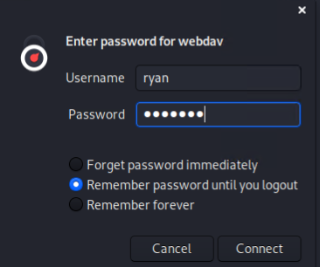
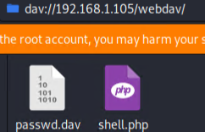
Exploitation: Weak Authentication Controls
03
01
Tools & Processes
Ryan’s account was brute forced by decrypting the MD5 hash then msfvenom was used to run a php reverse shell meterpreter session.
02
Achievements
The company’s web server was accessed through Ryan’s account. Then the malicious script was uploaded to the WebDAV server.

Slide 11

Blue Team
Log Analysis and Attack Characterization
11

Slide 12

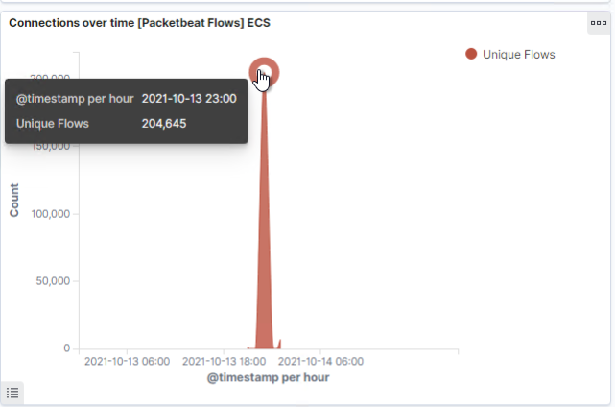
Analysis: Identifying the Port Scan
The scan occurred on October 13, 2021 at 2300.
204,645 connections occurred from host 192.168.1.90.
The intense and sudden peaks of traffic signify a port scan.
[Insert Here]
Include a screenshot of Kibana logs depicting the port scan.

Slide 13
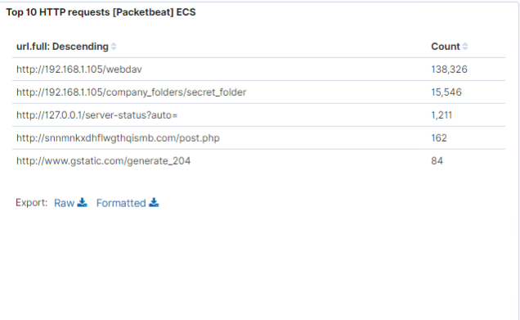
Analysis: Finding the Request for the Hidden Directory
There were 15,546 requests made to the /secret_folder directory on 10-13-2021 at 23:00 from IP 192.168.1.90.
The connect_to_corp.txt, which contained detailed instructions of how to connect to the company WebDAV with Ryan’s credentials (a hash is also provided).
[Insert Here]
Include a screenshot of Kibana logs depicting the request for the hidden directory.

Slide 14
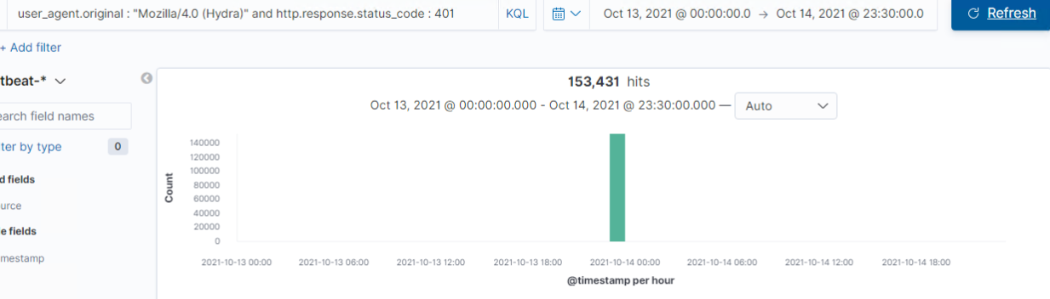
Analysis: Uncovering the Brute Force Attack
There were 15,541 total requests.
There were 15,531 requests made before the attacker discovered a password.
[Insert Here]
Include a screenshot of Kibana logs depicting the brute force attack.

Slide 15
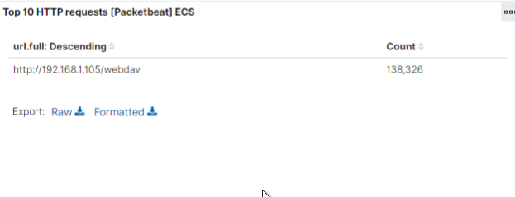
Analysis: Finding the WebDAV Connection
There were 138,326 requests made to the /webdav directory.
The requests were mainly for the passwd.dav and shell.php files. These contained the password for access to the WebDAV and a malicious script to start a shell.
[Insert Here]
Add a screenshot of Kibana logs depicting the WebDAV connection.

Slide 16
Blue Team
Proposed Alarms and Mitigation Strategies
16

Slide 17
Mitigation: Blocking the Port Scan
An IDS product can be used to monitor, alert and log potential port scans and suspicious traffic.
An alarm should be set to alert when a high number of port communications from a single IP address occur in a small window of time.
To activate the alarm, a threshold of more than 500 port communications from single IP address in a 60 second time frame could be set.
Use iptables to configure connection policies.
Use an IDS product to alert, log and potentially automatically block IP addresses attempting to listen on several ports.
Configure iptables policy on the local machine for suspicious IP addresses:
$ iptables -A INPUT -p tcp --dport ssh -s 192.168.1.90 -j DROP

Slide 18
Mitigation: Finding the Request for the Hidden Directory
An alarm should be set anytime unauthorized access is requested for hidden/confidential resources.
A threshold can be set for anytime there are five (5) or more attempts in an hour.
Rename resources to something less obvious (for example, secret_folder tells on itself), encrypt critical data so only those with a key can access it. Keep tabs on each IP that sends a request for these directories/files to either safelist or denylist.
Commands for iptables:
Safelist: - $ iptables -s <IP_Address_to_whitelist> -p tcp -m multiport --dports <chosen/accessible_destination_ports> -j ACCEPT
Denylist: - $ iptables -A INPUT -s IP-ADDRESS -j DROP

Slide 19
Mitigation: Preventing Brute Force Attacks
An alarm can be set to recognize when a 401 error is returned. This often signifies a bruteforce attack since it refers to a lack of valid credentials for a target resource.
While a 401 error in general is suspicious, I would set a threshold of ten (10) or more errors are made within an hour.
A better password policy can help mitigate brute force. A policy that locks out for 30 minutes after five (5) unsuccessful logins would work.
Also be sure to increase password complexity requirements for all employees, especially those with access to critical resources (like the WebDAV).

Slide 20
Mitigation: Detecting the WebDAV Connection
Anytime an unknown/trusted IP makes a GET request to the /webdav folder, send an alert out.
Theoretically, since all IPs that are trusted should be on the whitelist, the threshold would be when any number of GET requests are made by a non-whitelisted IP for the /webdav folder.
Establish/Create and maintain a whitelist of trusted IPs and set a firewall policy to block ALL other traffic. Also ensure users with access to the WebDAV folder have complex usernames and passwords.
Command to create iptable: $ iptables -s <IP_Address_to_whitelist> -p tcp -m multiport --dports 80,443 -j ACCEPT

Slide 21
Mitigation: Identifying Reverse Shell Uploads
An alarm should be set to alert anytime a file is uploaded to the WebDAV server from a non-whitelisted IP.
This alarm should be activated any time one (1) or more files are uploaded from a non-whitelisted IP address.
Another alarm should be set to notify when the WebDAV server reaches out for a connection. Web servers should have incoming traffic, not outgoing traffic.
Configurations to set on the host to block file uploads:
Set permissions to block access to the file upload system from any IP which is not whitelisted.
sudo chmod 770 <file_upload_directory>
Restrict types of files which can be uploaded ex .php, .xss, .rar
Set firewall rules to block incoming traffic from all ports other than those specified.
Block inbound/outbound traffic to suspicious ports such as 4444.

